Slide 1
ViT and VLMs and Multimodal LLMs
Text, Audio, Image, Video all at once
John R. Ballesteros
Ph.D Full Professor UNAL

Slide 2
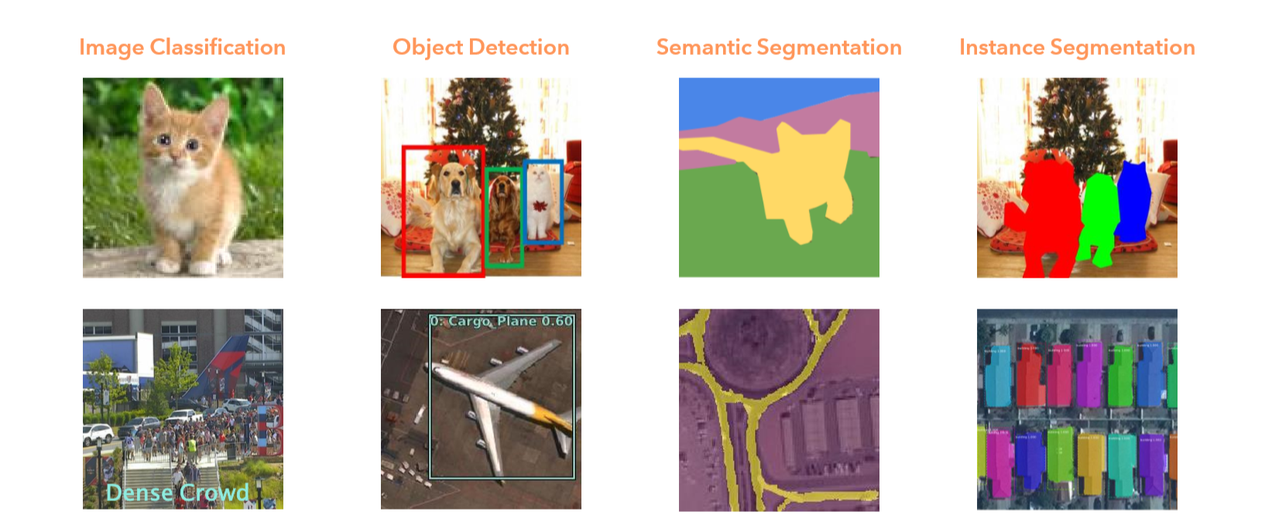
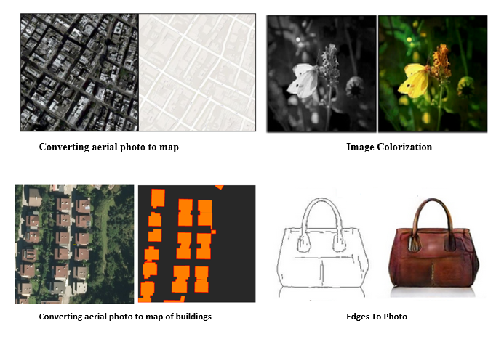
Vision Methods
Image Generation/Translation
CNN
RNN & GAN

Slide 3
AN IMAGE IS WORTH 16X16 WORDS: TRANSFORMERS FOR IMAGE RECOGNITION AT SCALE
ViT tesselates images (16x16) in linear sequences and inputs them to Transformers in a supervised manner.
ViT applied in image recognition improved in performance compared to CNN, specifically when pre-trained over billion examples and computing requirements.
ViT-H/14: means vision transformer huge 14x14

Slide 4
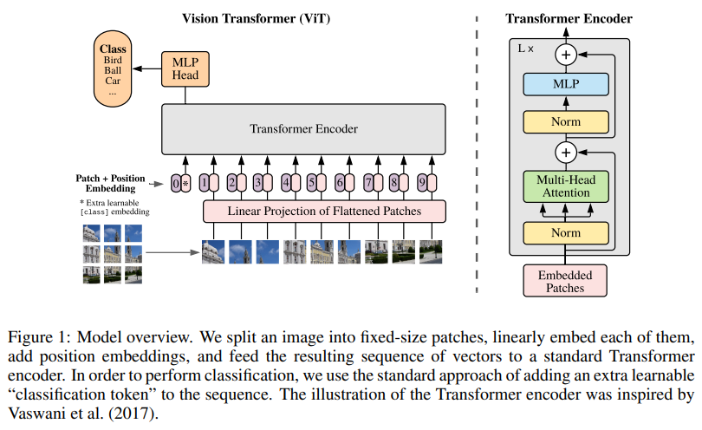

Slide 5
94.55% en CIFAR-100, in ImageNet, ViT-L/16 scored 87.76% vs 87.54% of BiT-L
Convolutions are better for small datasets imposing induvtive biases, ViT overcome this problem learning directly from data (100M-300M images)
What about combining CNN and Transformers? It lightly surpasses ViT on small, but not on large datasets.
It’s good practice to fine tune, use a pre-trained general model, using a very specific high resolution dataset.

Slide 6
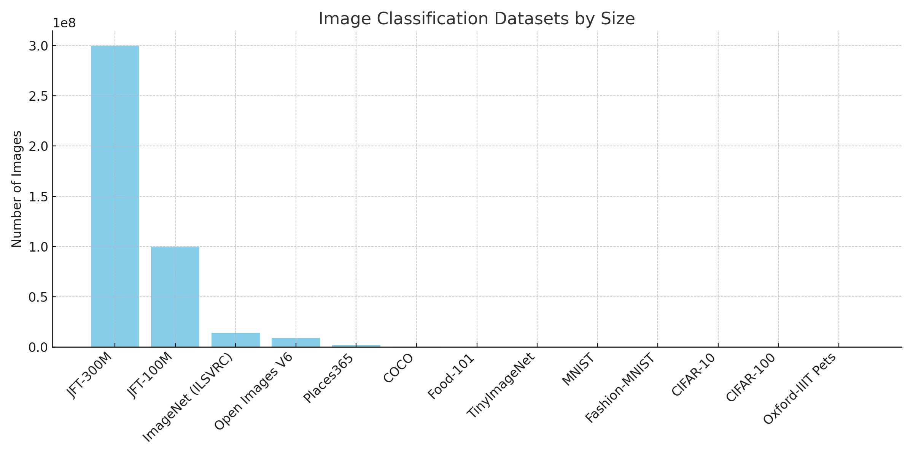

Slide 7
Vision Language Models (VLMs)
AI systems designed as a unified framework for multiple vision tasks, including object detection and segmentation, with a focus on efficiency and versatility.

Slide 8
CLIP (Contrastive Language-Image Pretraining)
Open sourced by OpenAI
Vision-language model that embeds text and images into a shared space
Enables zero-shot classification (classes not explicitly seen in training) and cross-modal retrieval.

Slide 9
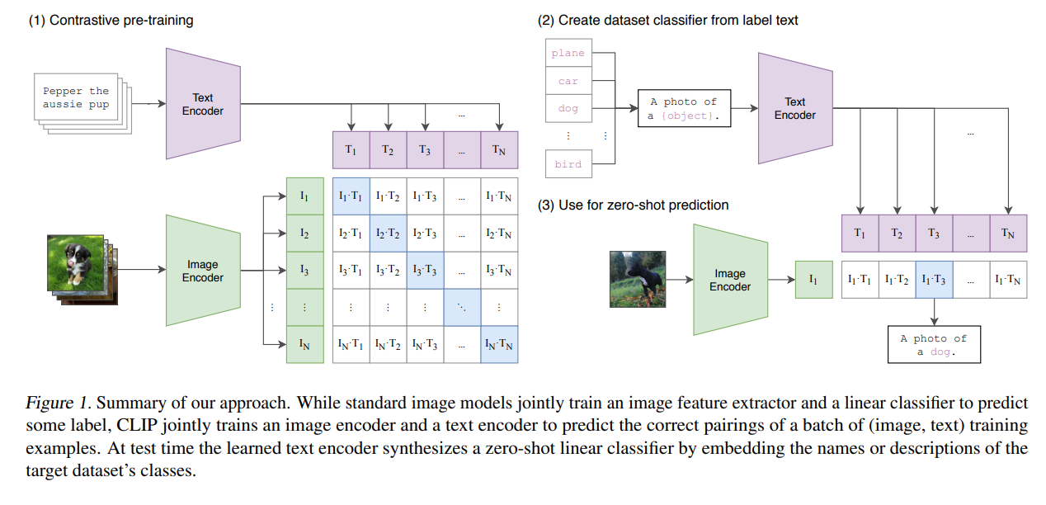
Trained on a dataset of 400 million (image, text) pairs collected from the internet.
https://arxiv.org/pdf/2103.00020
Alec Radford et al, 2021

Slide 10
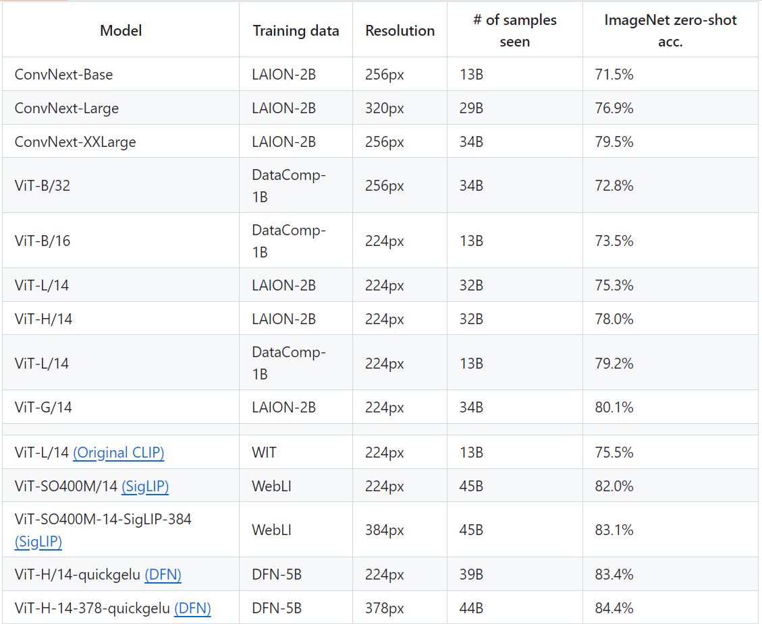

Slide 11
Applications
Create an image classification model for:
people with mask or not
a person wearing glasses
is there a fachade?

Slide 12
OWL-ViT: Open-World Localization with Vision Transformers
Open-sourced by Google Research
Vision-language model based on CLIP. Enables zero-shot detection of objects based on free-form text prompts (e.g., “detect a dog”).
Can generate bounding boxes, which SAM can use to produce segmentation masks. Detection relies on accurate text prompts, and ambiguous or poorly phrased prompts may reduce performance.

Slide 13
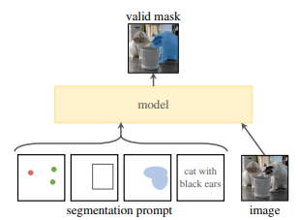
SAM (Segment Anything Model = Spatial Attention Model), Version 3 now Available !
Open source
Meta Ai
Instance segmentation
Zero Shot Segmentation

Slide 14
Grounding DINO By Google
Open Source
DINO stands for Self-DIstillation with NO labels — it's the name of the original vision Transformer detector model developed by Facebook Research in 2021.
Detects novel categories described in natural language without any fine-tuning, outperforming prior open-vocabulary detectors.

Slide 15
LLaVA (Large Language and Vision Assistant)
Open-sourced by Microfost
Combines Vicuna-13B with ViT-L/14.
General-purpose visual and language understanding. Enables natural conversation about image content, visual QA, and detailed scene description at low training cost.

Slide 16
Apple Ferret
Open-source MLLM
Focus on spatial understanding through referring and grounding
Enables precise recognition of image regions. Mapping text to exact pixel locations, can handle inputs like "what is the object at coordinates [120, 340]?"

Slide 17
Florence-2 (Microsoft)
Open-source, one model different tasks by prompts.
Processes text prompts for task-specific detection (e.g., “Detect all people in the image”).
Supports instance and semantic segmentation out-of-the-box, making it versatile for segmentation tasks on datasets like COCO.

Slide 18
PaliGemma (Google DeepMind)
Open source
Object detection and segmentation
Combines SigLIP vision encoder with Gemma language model into a compact, optimized for fine-tuning.

Slide 19
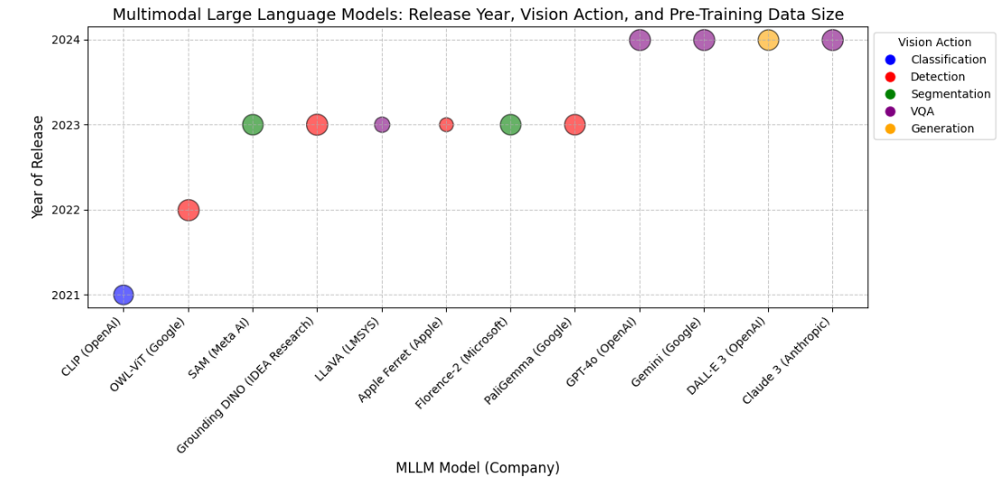

Slide 20
At a Glance
Each model's primary strength — one phrase
Model | By | ⭐ Core Strength | Primary Use
ViT | Google Research | Scalable image understanding | Image classification at scale
CLIP | OpenAI | Zero-shot cross-modal understanding | Zero-shot classification, image search
OWL-ViT | Google Research | Text-prompted bounding box detection | Open-world object detection
SAM | Meta AI | Universal zero-shot segmentation | Instance segmentation, mask generation
Grounding DINO | IDEA Research / Google | Language-grounded open-set detection | Open-vocabulary object detection
LLaVA | Open-source (UW/Microsoft) | Conversational visual reasoning | Visual QA, image chat, scene description
Apple Ferret | Apple | Fine-grained spatial referring & grounding | Precise region recognition, spatial QA
Florence-2 | Microsoft | Unified multi-task vision via prompts | Detection, segmentation, captioning — all in one
PaliGemma | Google DeepMind | Efficient open multimodal foundation model | Detection, segmentation, VQA, fine-tuning
Lecture 8 · John R. Ballesteros, Ph.D · UNAL

Slide 21
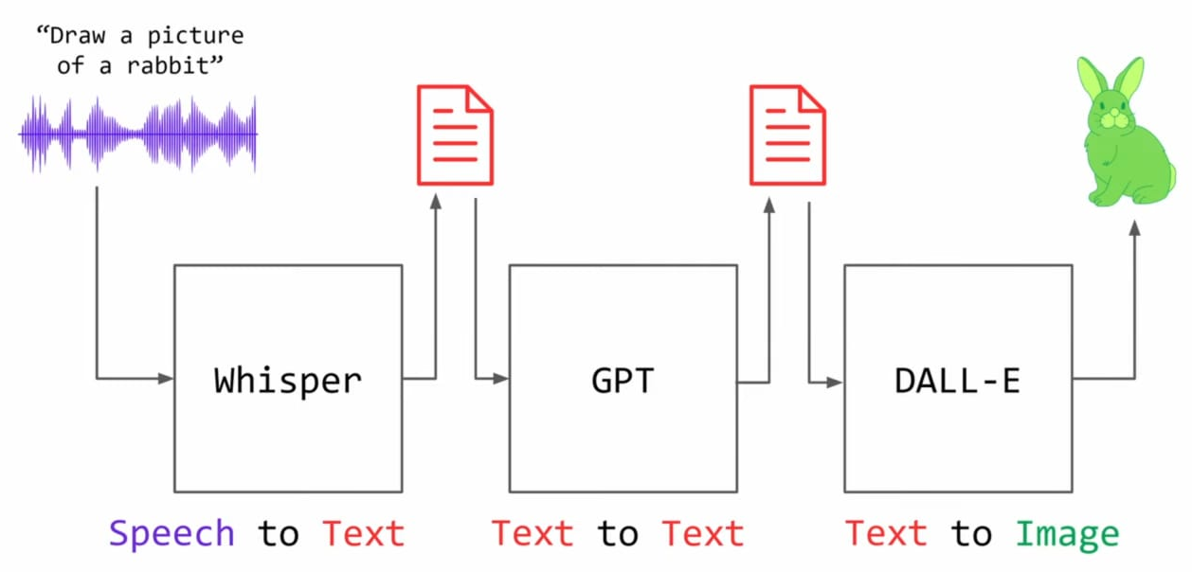
Multimodal Large Language Models (MLLMs)
AI systems that process and generate multiple data types: text, images, audio or video for image captioning, visual question answering, and cross-modal reasoning.
Taken from OpenAi 2024 technical document

